Slide 1
Aggieland Art Trail
Srijith, Ashwin Raja, Hanrui Chen, Hector Cardenas, Patrick Zhong, Pratheek B.R.

Slide 2
Describe the application
Walk through major use cases
Explain design choices you made while working the project
Introduce your application, your design, and challenges and lessons you have learned about the software engineering process.

Slide 3
Application Background
Aggieland Art Trail
Highlights local artworks, murals, monuments, and businesses in Bryan-College Station
Created and hosted by the Visual Art Society, a local volunteer, non-profit organization
The need: art trail as a mobile-first application
Provides users with a map highlighting the attractions available
Encourages engagement through the awarding of stamps and badges
Simplicity: ease of use for all age groups
Engaging: make the trail fun to participate in
Maintainable: easy to update and rotate featured art without much technical expertise

Slide 4
Use Cases
Tourist
Users new to the area, perhaps checking out prospective schools or attending a football game and would like to see the local sights, and therefore are unfamiliar with the area
Individual
An user visiting art pieces by themselves, perhaps competing with other individual users or their family.
Family
A family visiting art pieces together as a fun weekend activity, with age ranges from youth to elderly - important to be engaging for the kids but easy enough to use for the parents and grandparents.
Competition with other families.
School group
Required or extra-credit activity that local schools can assign students to participate in to bolster their curriculum or encourage students to visit art exhibits.
Engagement system used to track activity progress and/or encourage competition.

Slide 5
Design
Application with limited but important features
Focused on the map
Users click specific art piece on the map and get a description of it
To make walking the trail more fun:
Award stamps for visiting art pieces
Award badges for achieving milestones such as earning a certain amount of stamps
Community engagement:
Art pieces link to the main art trail website
Announcement page showcasing community Facebook feed
Administrator maintenance:
Admins will be able to add and delete featured works
Track engagement statistics for admin feedback

Slide 6
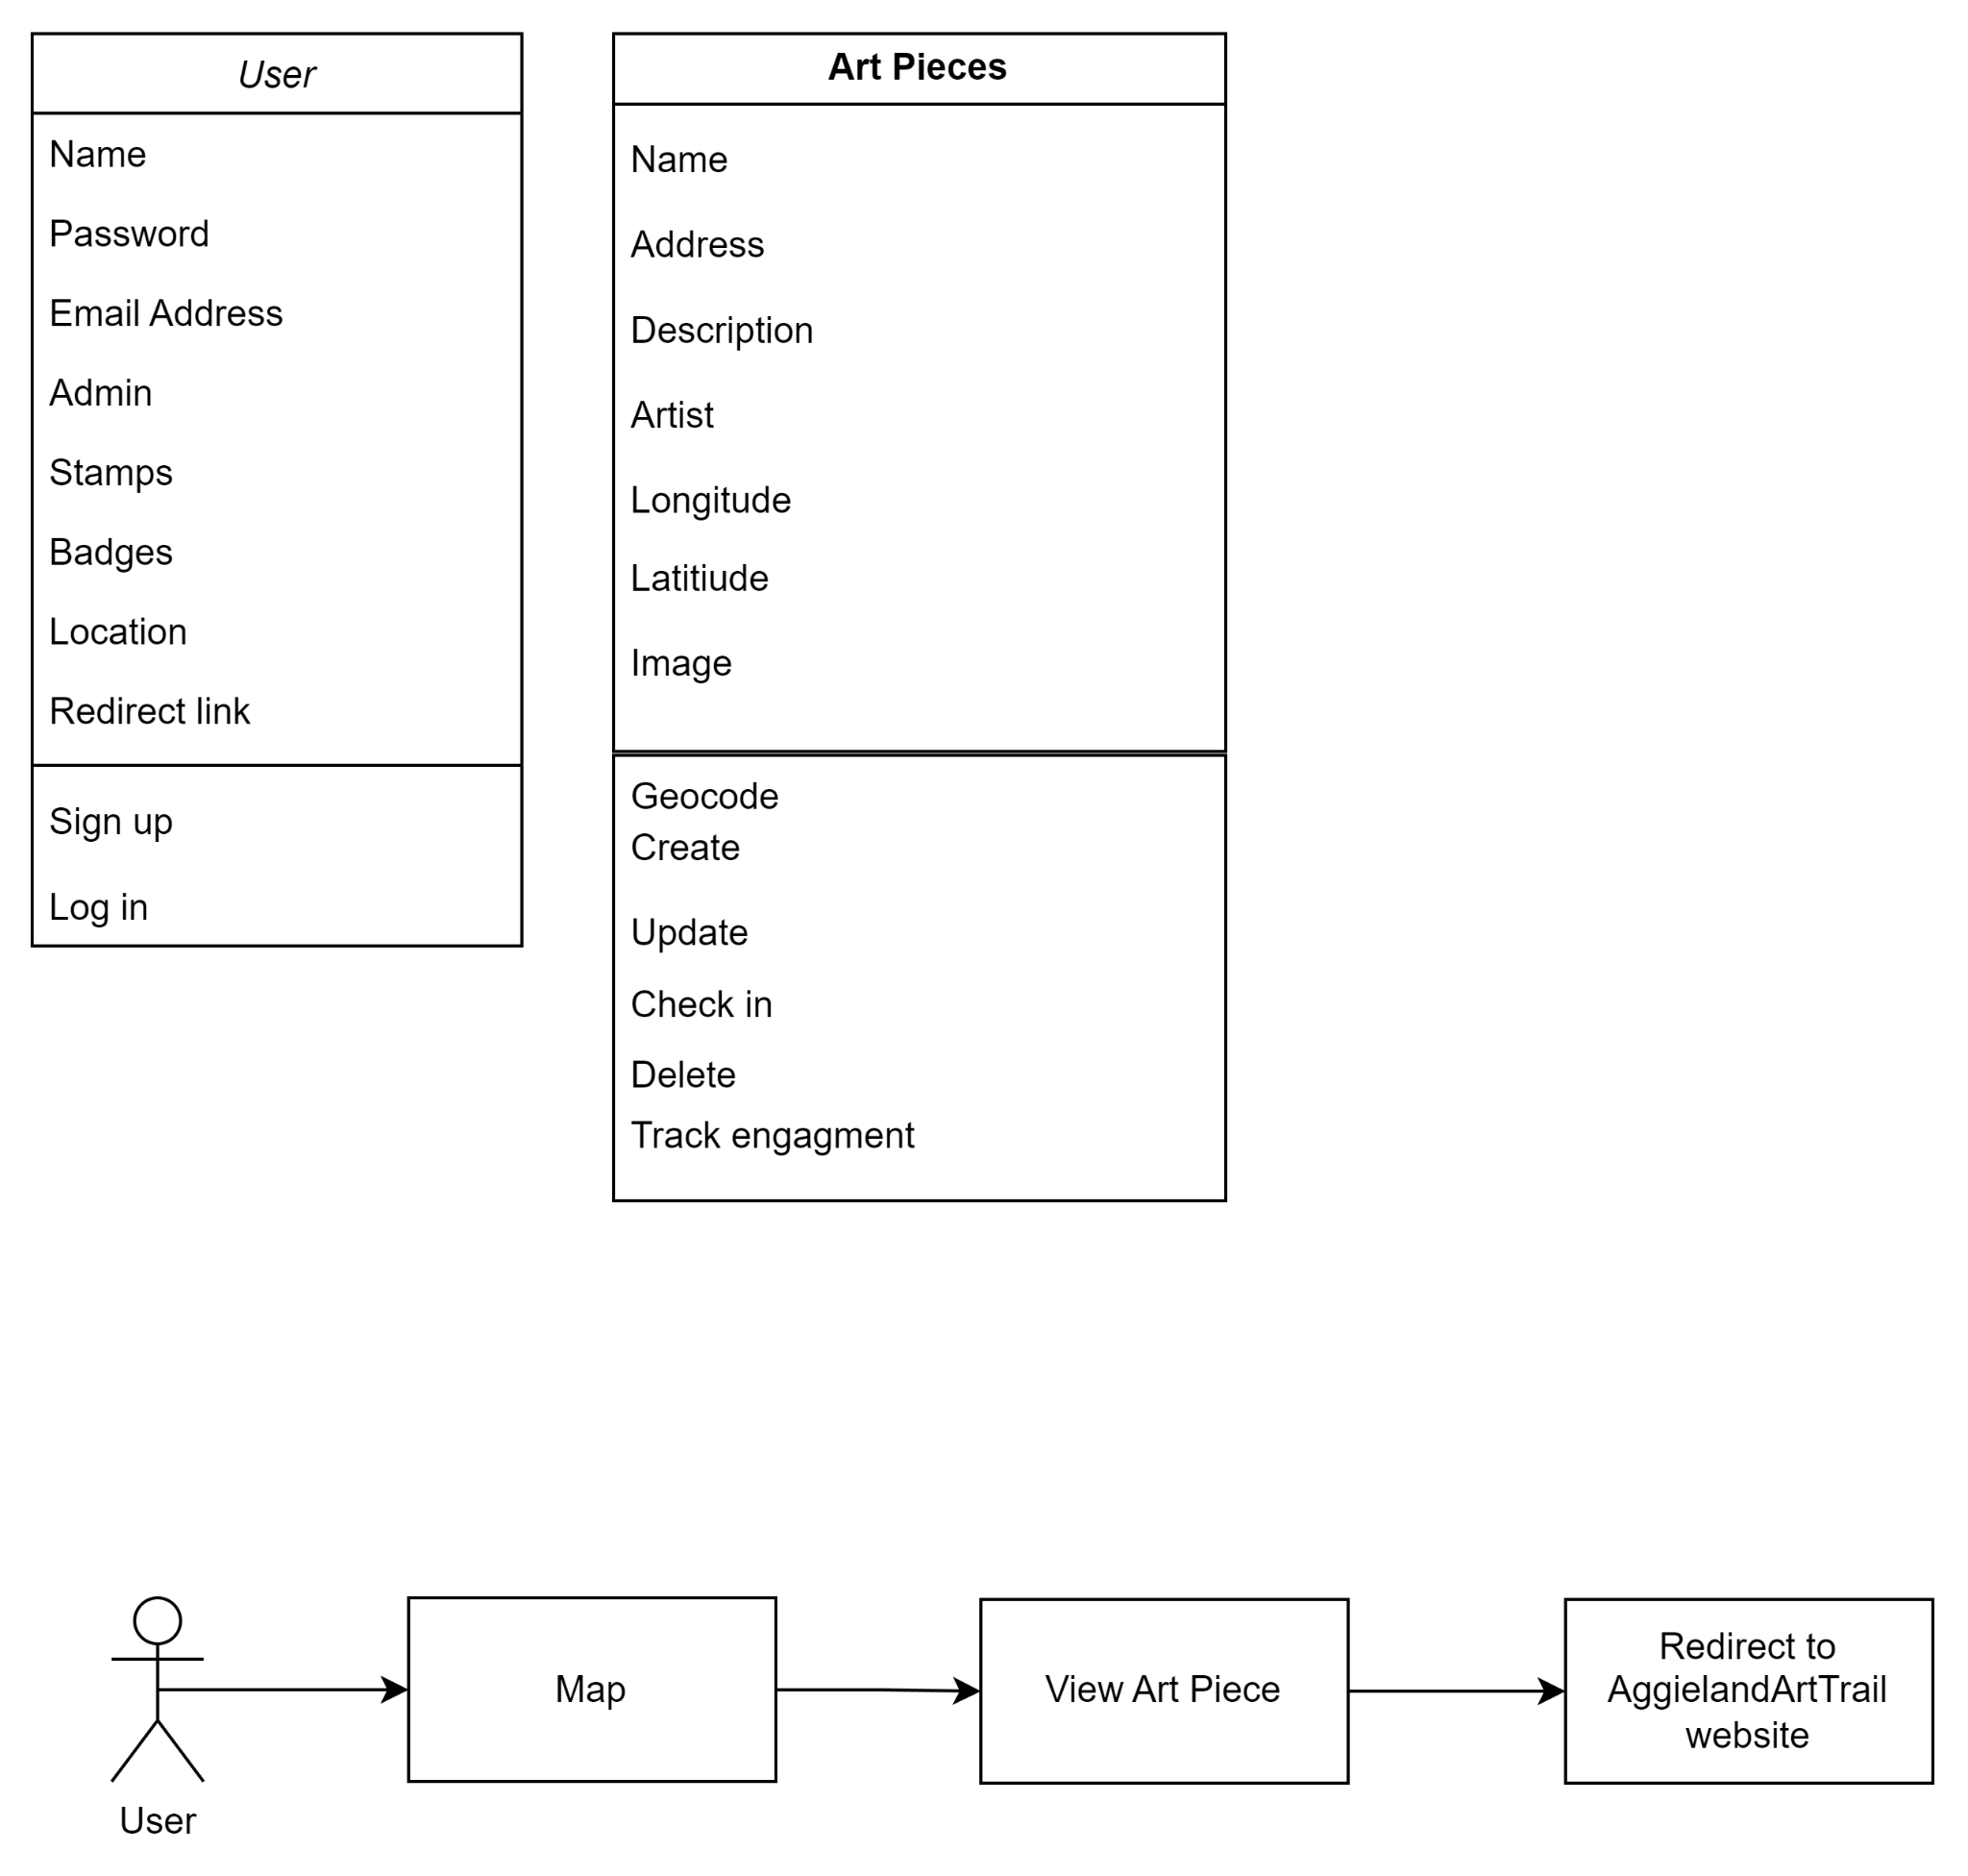
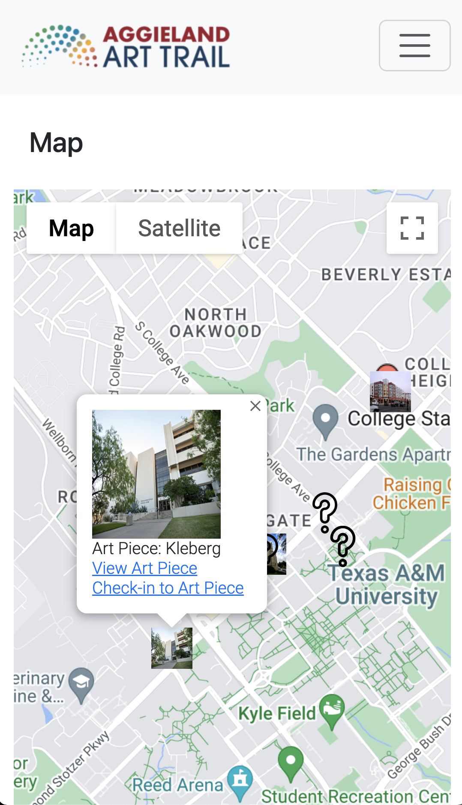
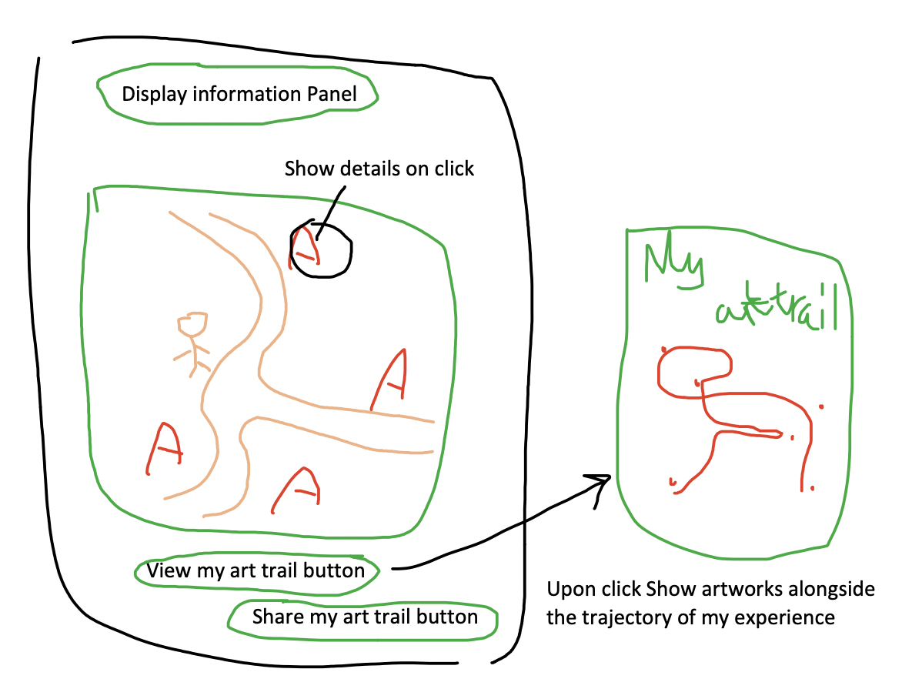
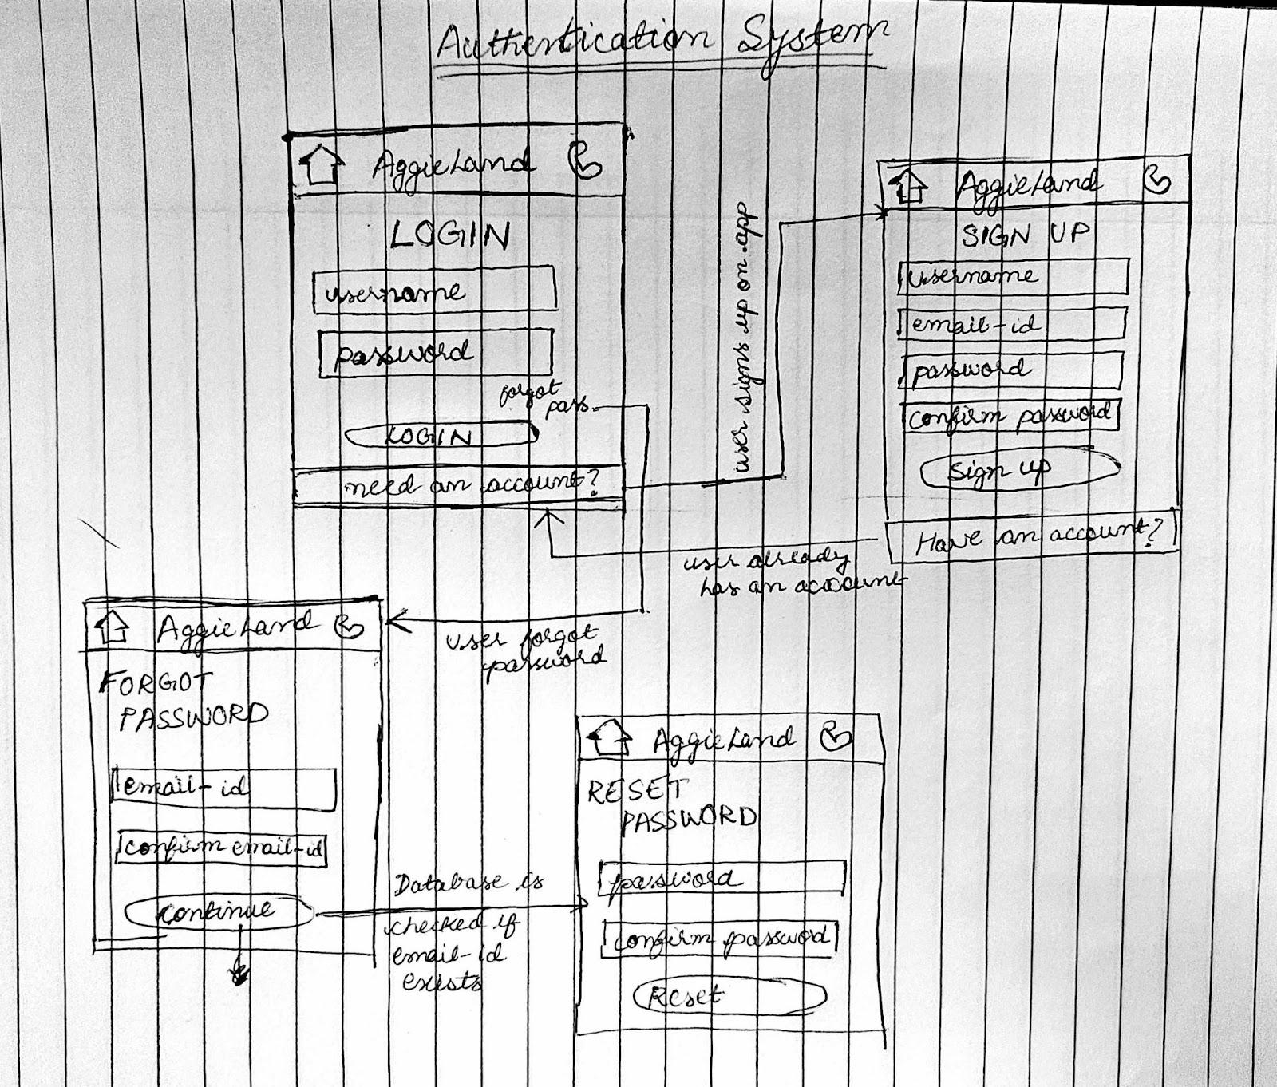
Design
Application with limited but important features
Focused on the map
Users click specific art piece on the map and get a description of it

Slide 7
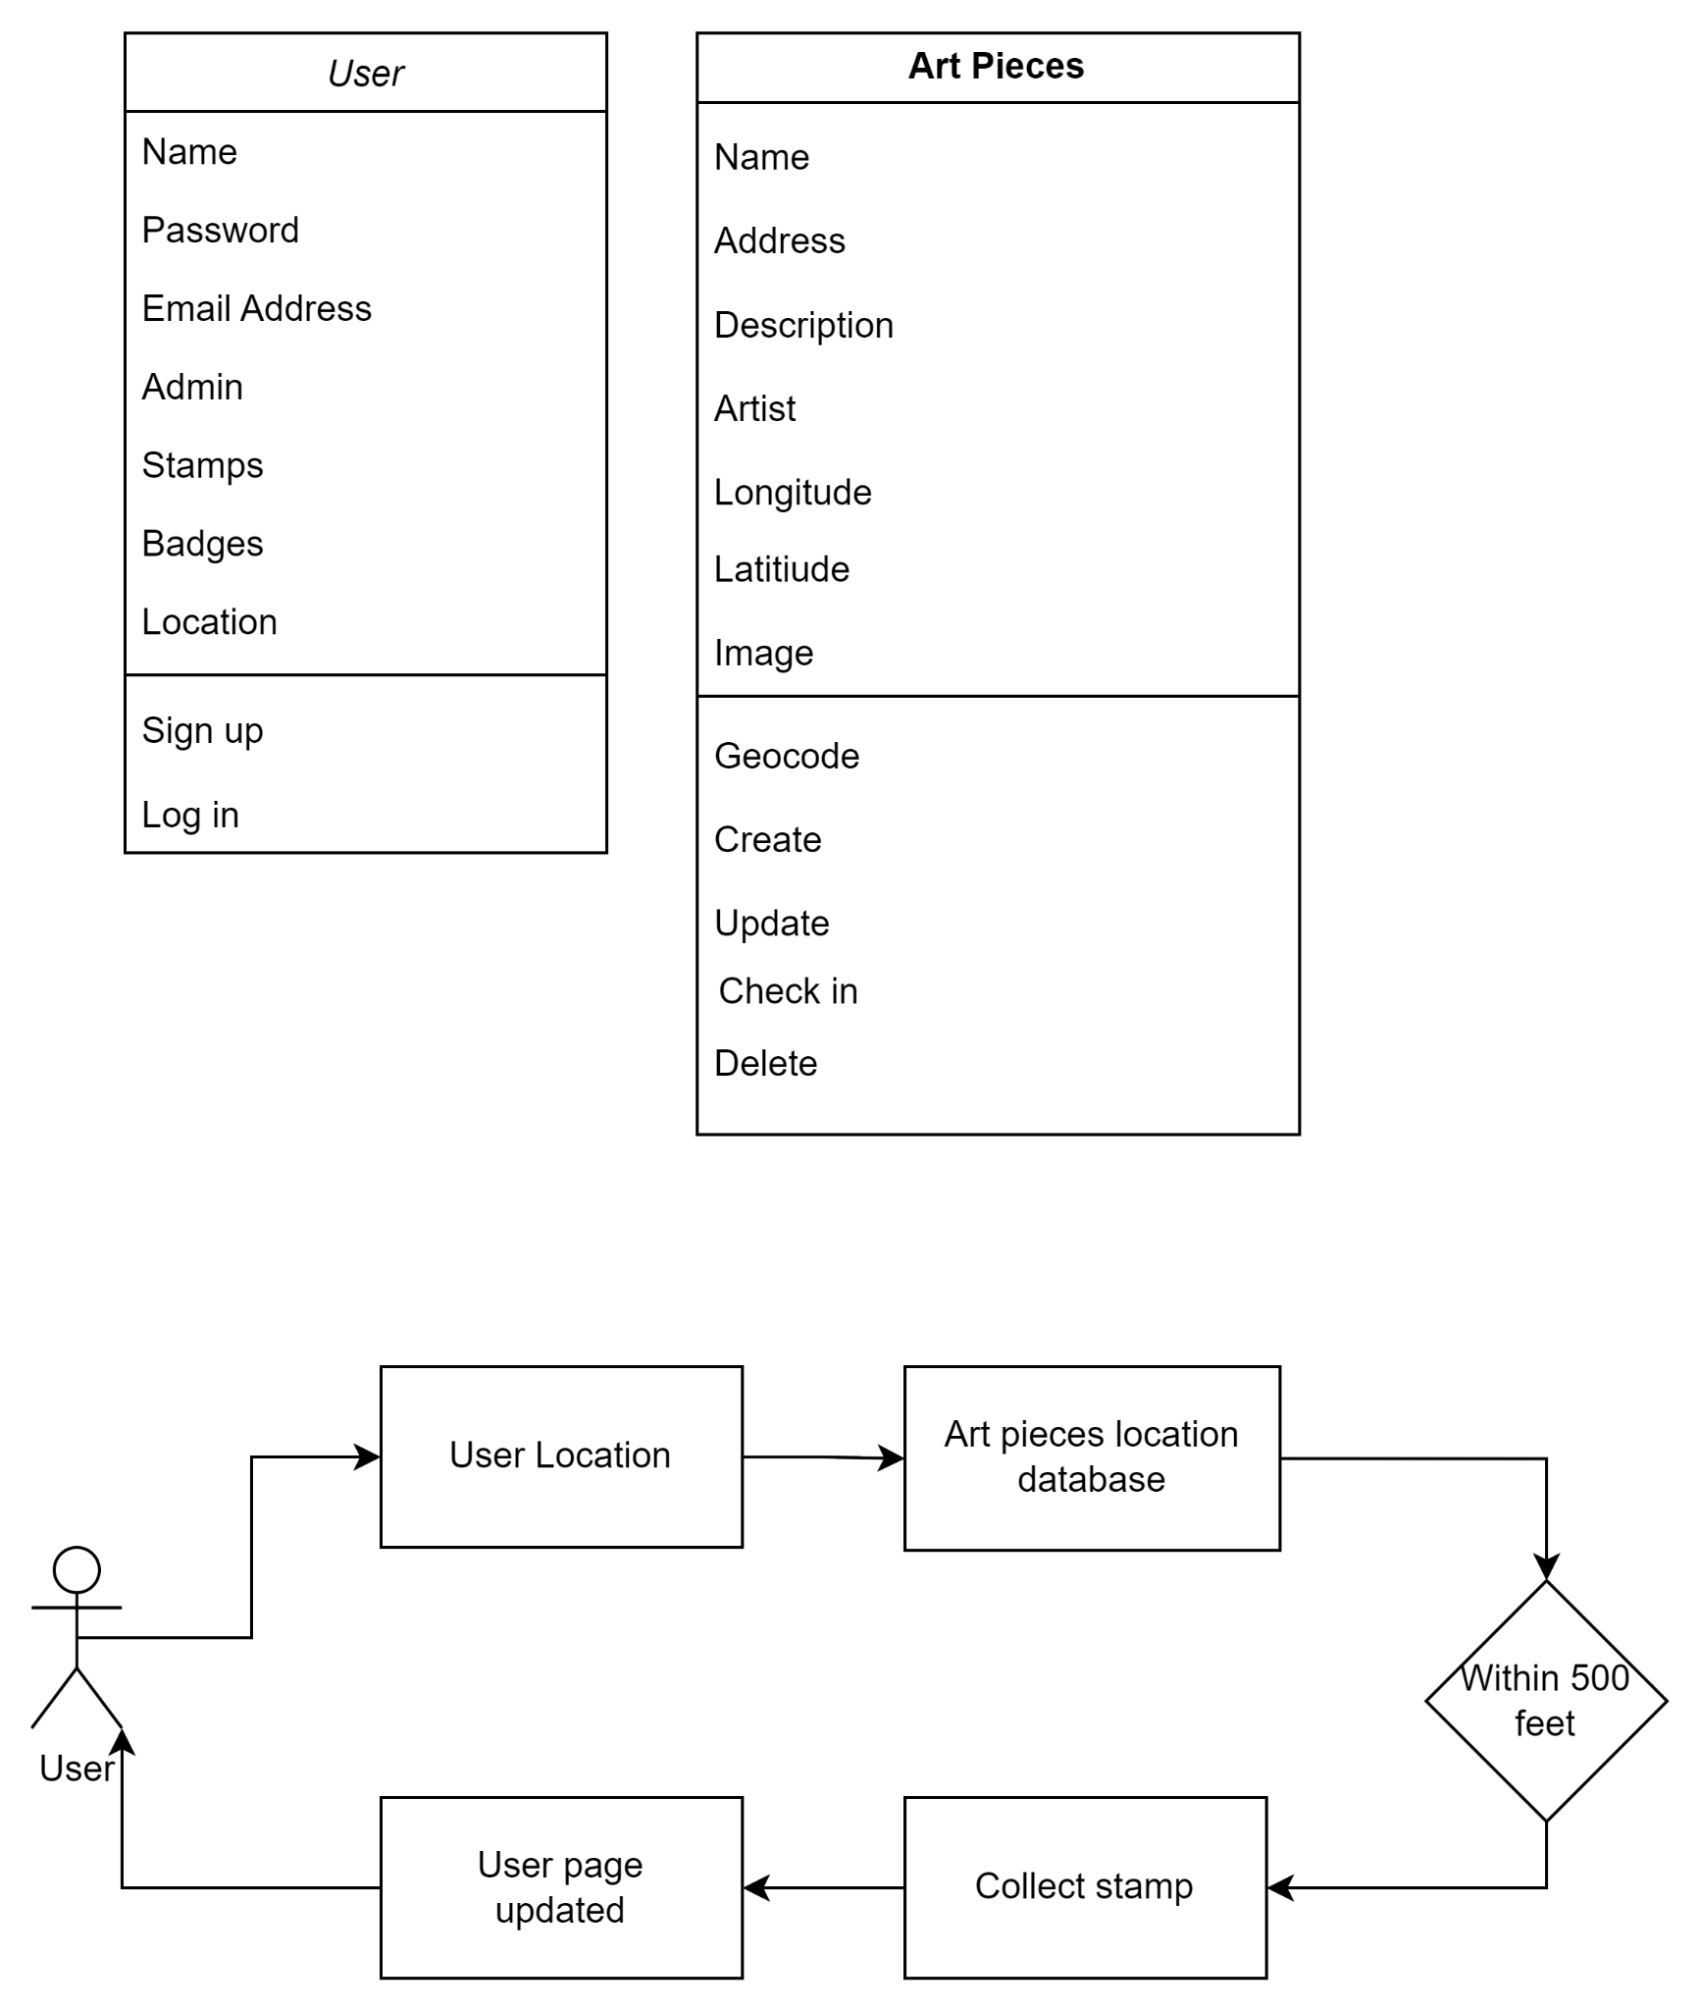
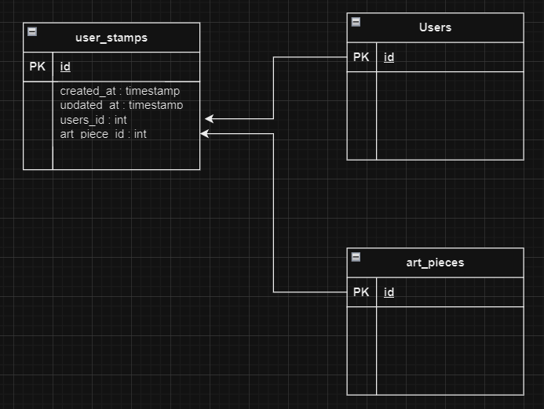
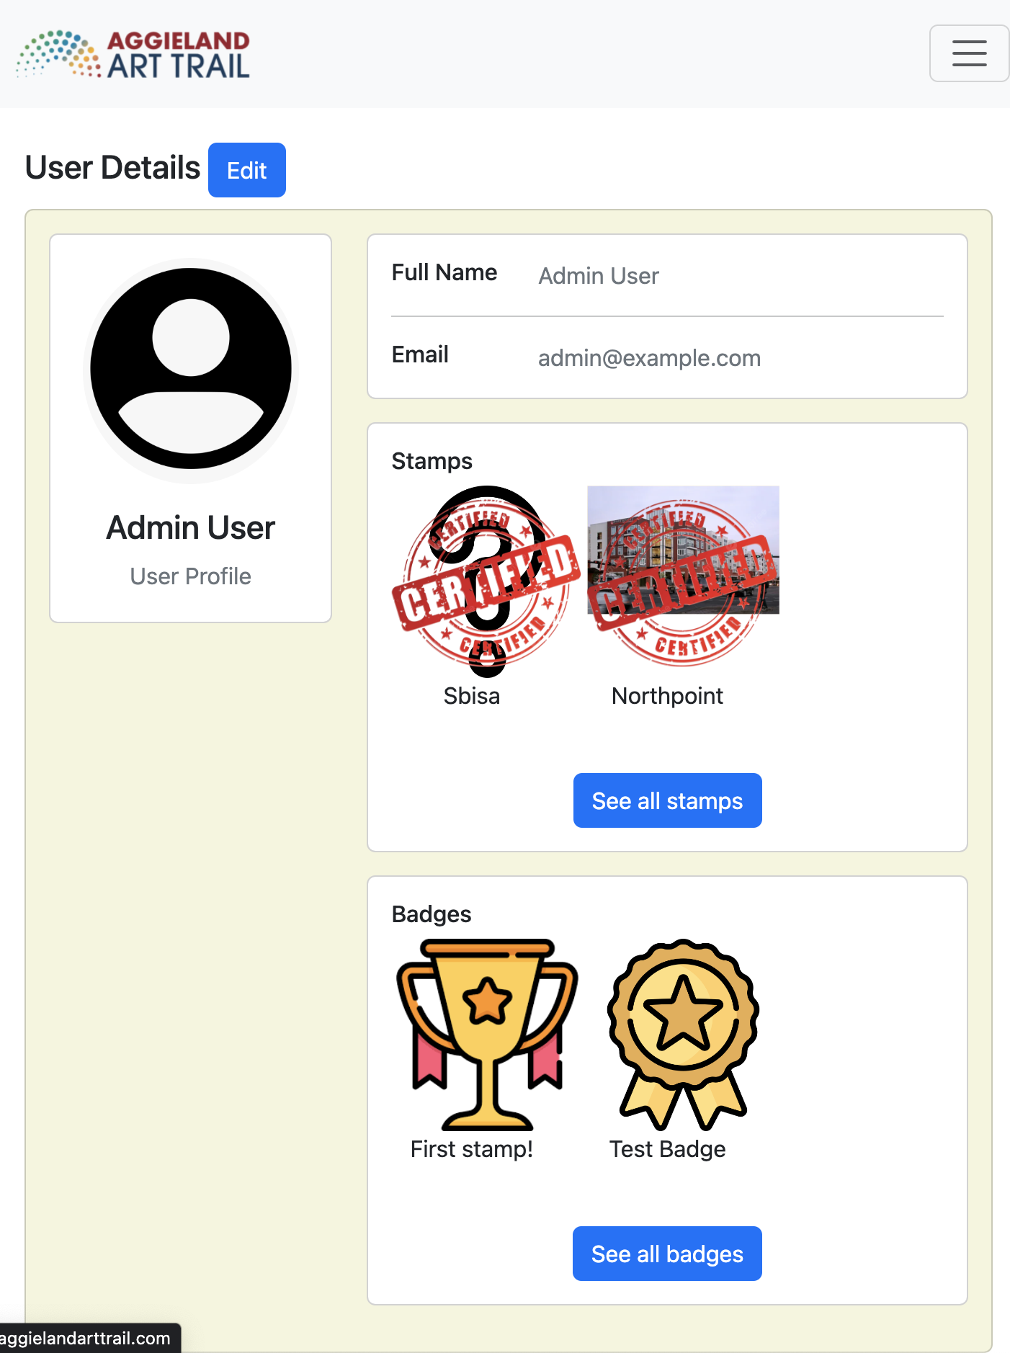
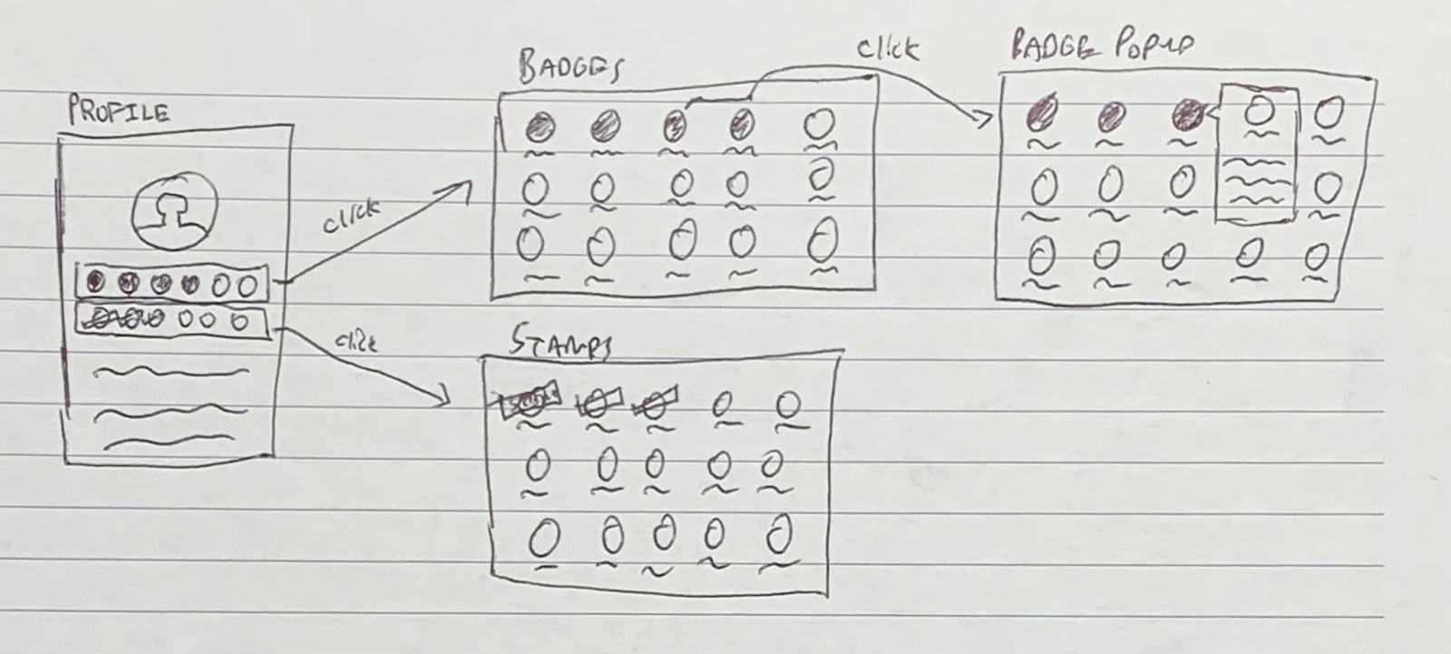
Design
To make walking the trail more fun:
Award stamps for visiting art pieces
Award badges for achieving milestones such as earning a certain amount of stamps

Slide 8
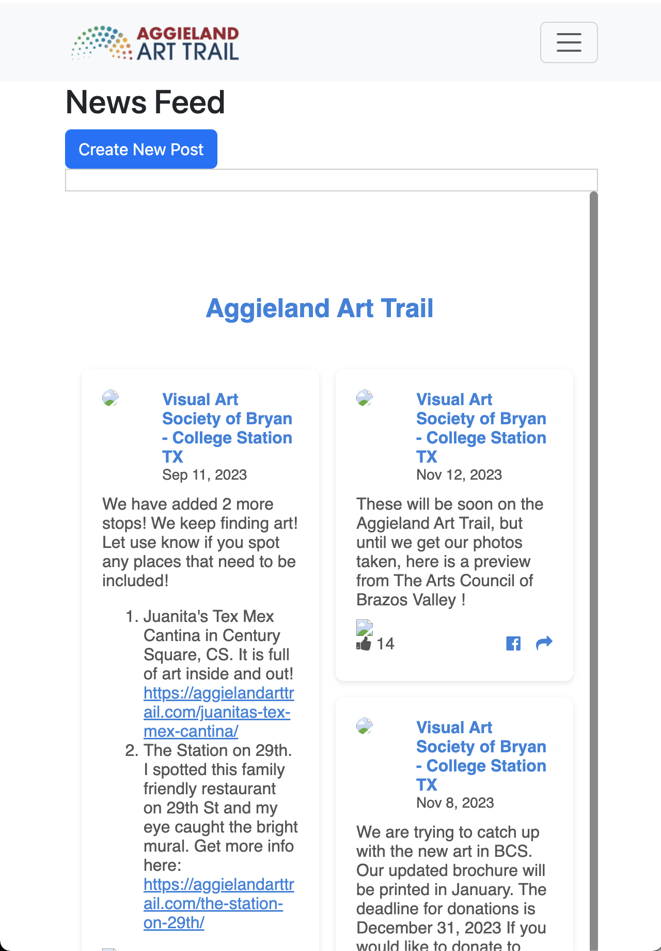
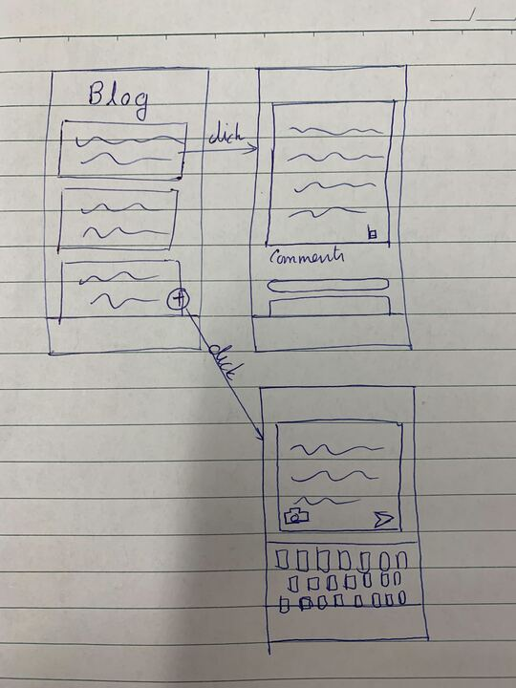
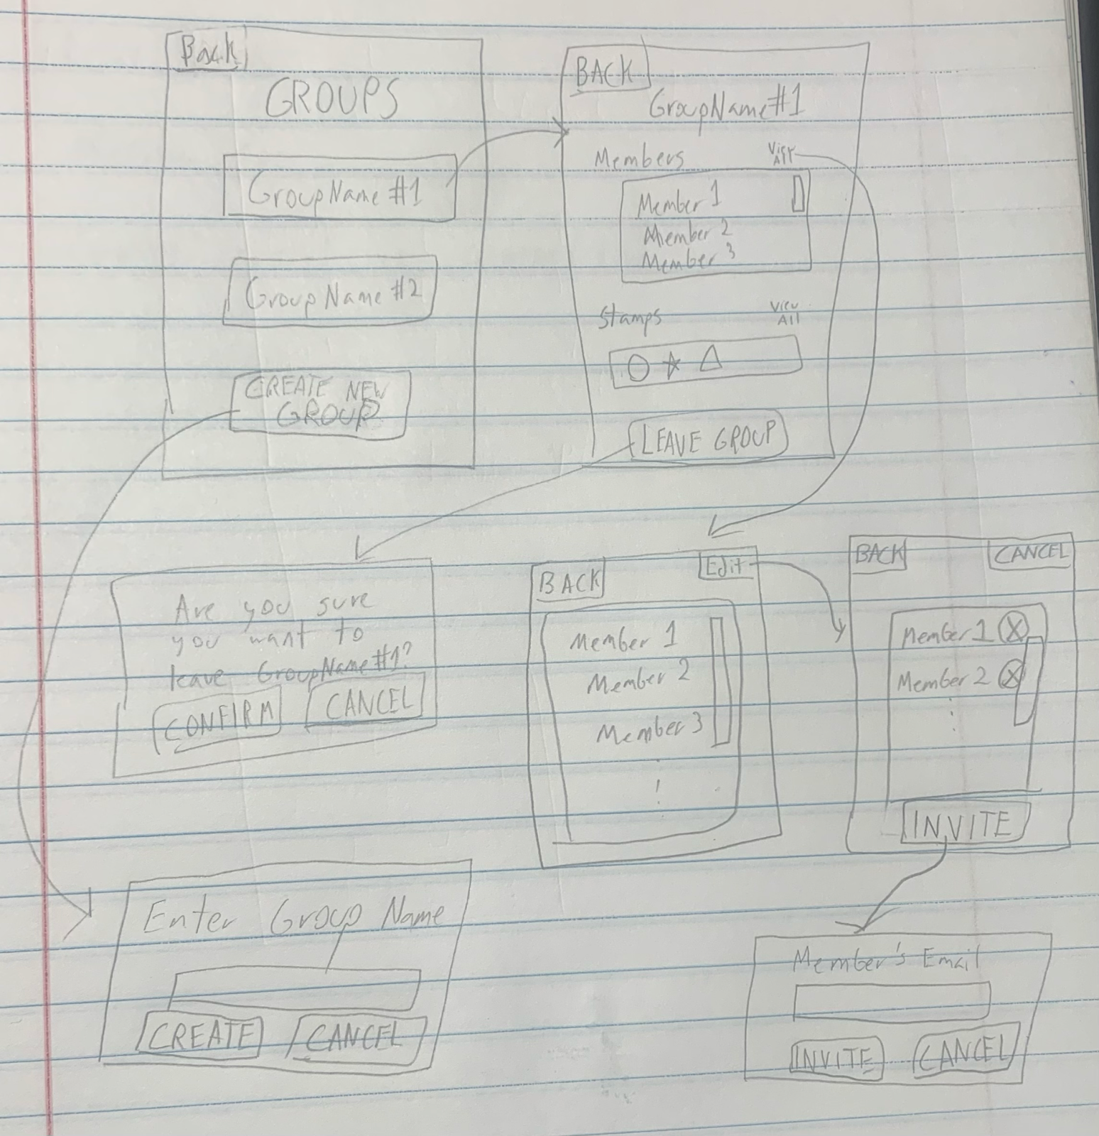
Design
Community engagement:
Art pieces link to the main art trail website
Announcement page showcasing community Facebook feed

Slide 9
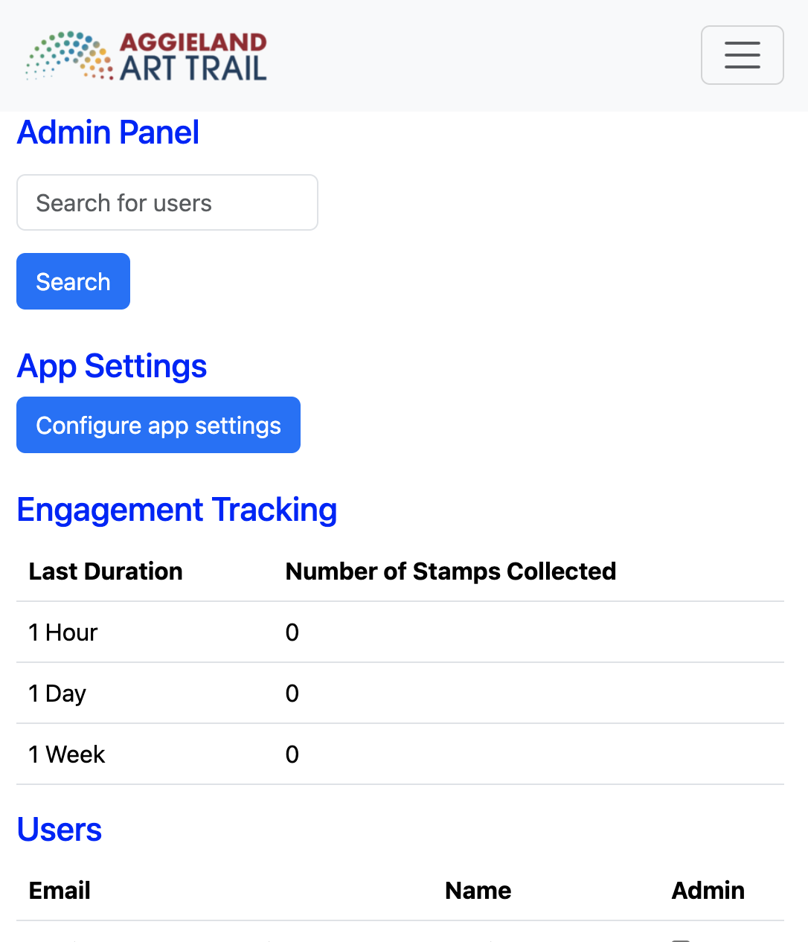
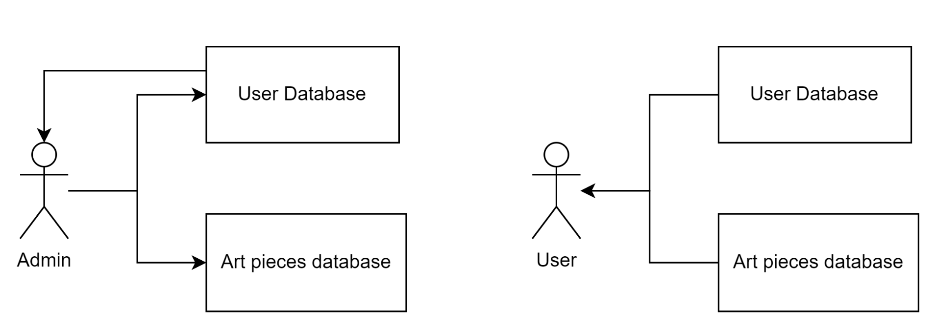
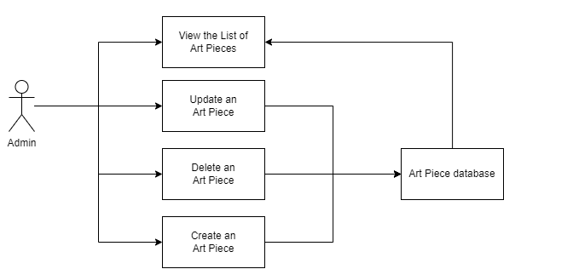
Design
Administrator maintenance:
Admins able to add and delete featured works
Track engagement statistics for admin feedback

Slide 10
Challenges and Lessons Learned
Image uploading:
Initially tried via Ruby processing and storing images in static assets folder
Heroku Dyno refreshes frequently, deleting new uploaded assets
Usage of Rails ActiveStorage with Amazon Web Services S3 bucket much smoother
More in line with the Ruby/Rails paradigm as the image is incorporated into the model, rather than searching for files by name on disk
Although, requires more setup with encrypted keys and master key files
Stamp and badge checking:
Initially used integer with bits corresponding to art pieces (0 for no stamp, 1 for stamp)
Easier to set up, but does not handle deletion of art pieces well nor natively supports bulk actions like SQL does (e.g. find all art pieces with 1)
Better solution: foreign key tables
Heroku map assets issues:
Map functions worked locally, but not on Heroku
Rails assets were not being parsed correctly in JavaScript
Solution: upload all assets or files related to JavaScript to an AWS web service

Slide 11
Demo

